Slide 1





Student Council
QUEEN OF APOSTLES

Slide 2

Student Council
Student Council is a group of students, chosen by their classmates, to represent the school, share student ideas and plan activities.

Slide 3








Our Members
4th & 5th Grades Class Representatives (2 per grade)
6th Grade Classroom Representative
7th Grade Classroom Representative
8th Grade Classroom Representative
Student Council General Members (6th - 8th Grades)
Student Council Secretary
Student Council Vice-President
Student Council President

Slide 4
Student Council
General Members
  does not have to be elected
  help with Student Council sponsored activities and projects
  attend meetings

Slide 5
Classroom Reprsentative
  attend meetings
  work on student council projects and activities before or after school hours
  report information back to your classroomm
  listen to the opinions of the class you represent
  participate in Student Council sponsored activities and projects and encourage others to do so

Slide 6
Secretary
  works with advisor to prepare an agenda for Student Council meetings
  keeps a record of attendance for Student Council
  handles written correspondence (flyers, handouts, etc.)
  participate in Student Council sponsored activities and projects and encourage others to do so

Slide 7
Vice-President
  presides over the Student Council meeting in the absence of the president
  is in charge of committee and participant sign-up/volunteers
  participate in Student Council sponsored activities and projects and encourage others to do so

Slide 8
President
  presides over the Student Council meetings
  guides discussion, summarizes and clarifies meeting information if needed
  sees that all projects are carried out
  participate in Student Council sponsored activities and projects and encourage others to do so

Slide 9
Advocacy
Advocacy is an activity by an individual
or group which aims to support a person, idea or task.
BUILD COMMUNITY
SERVICE TO OTHERS
LEADERSHIP
TEAMWORK

Slide 10
How does
student council help the school?
The Student Council helps students work together to improve our school through leadersip, service and teamwork.
Student Council members will help come up with school-wide activities, service projects, community building events and much more!

Slide 11

Do you.......
  want to be part of deciding and planning projects and activities?
  like working and planning with other kids?
  have time to work on Student Council projects?
  want to be in a leadership role for the right reasons - to serve, to work and to care?
Can you.......
  listen and accept suggestions from other kids, even kids you are not close friends with?
  ask for help?
  accept constructive criticism?

Slide 12

Our Plans
  meet approximately twice a month during lunch/recess
  create a school-wide service project
  plan an after school event for students
  raise funds for a cause
  collaborate with Queen of Apostles faculty and staff to build community

Slide 13

Next Steps
APPLY TO BE A MEMBER
APPLY TO BE A CANIDATE
START YOUR CAMPAIGN
CANIDATE SPEECHES
VOTING

Slide 14
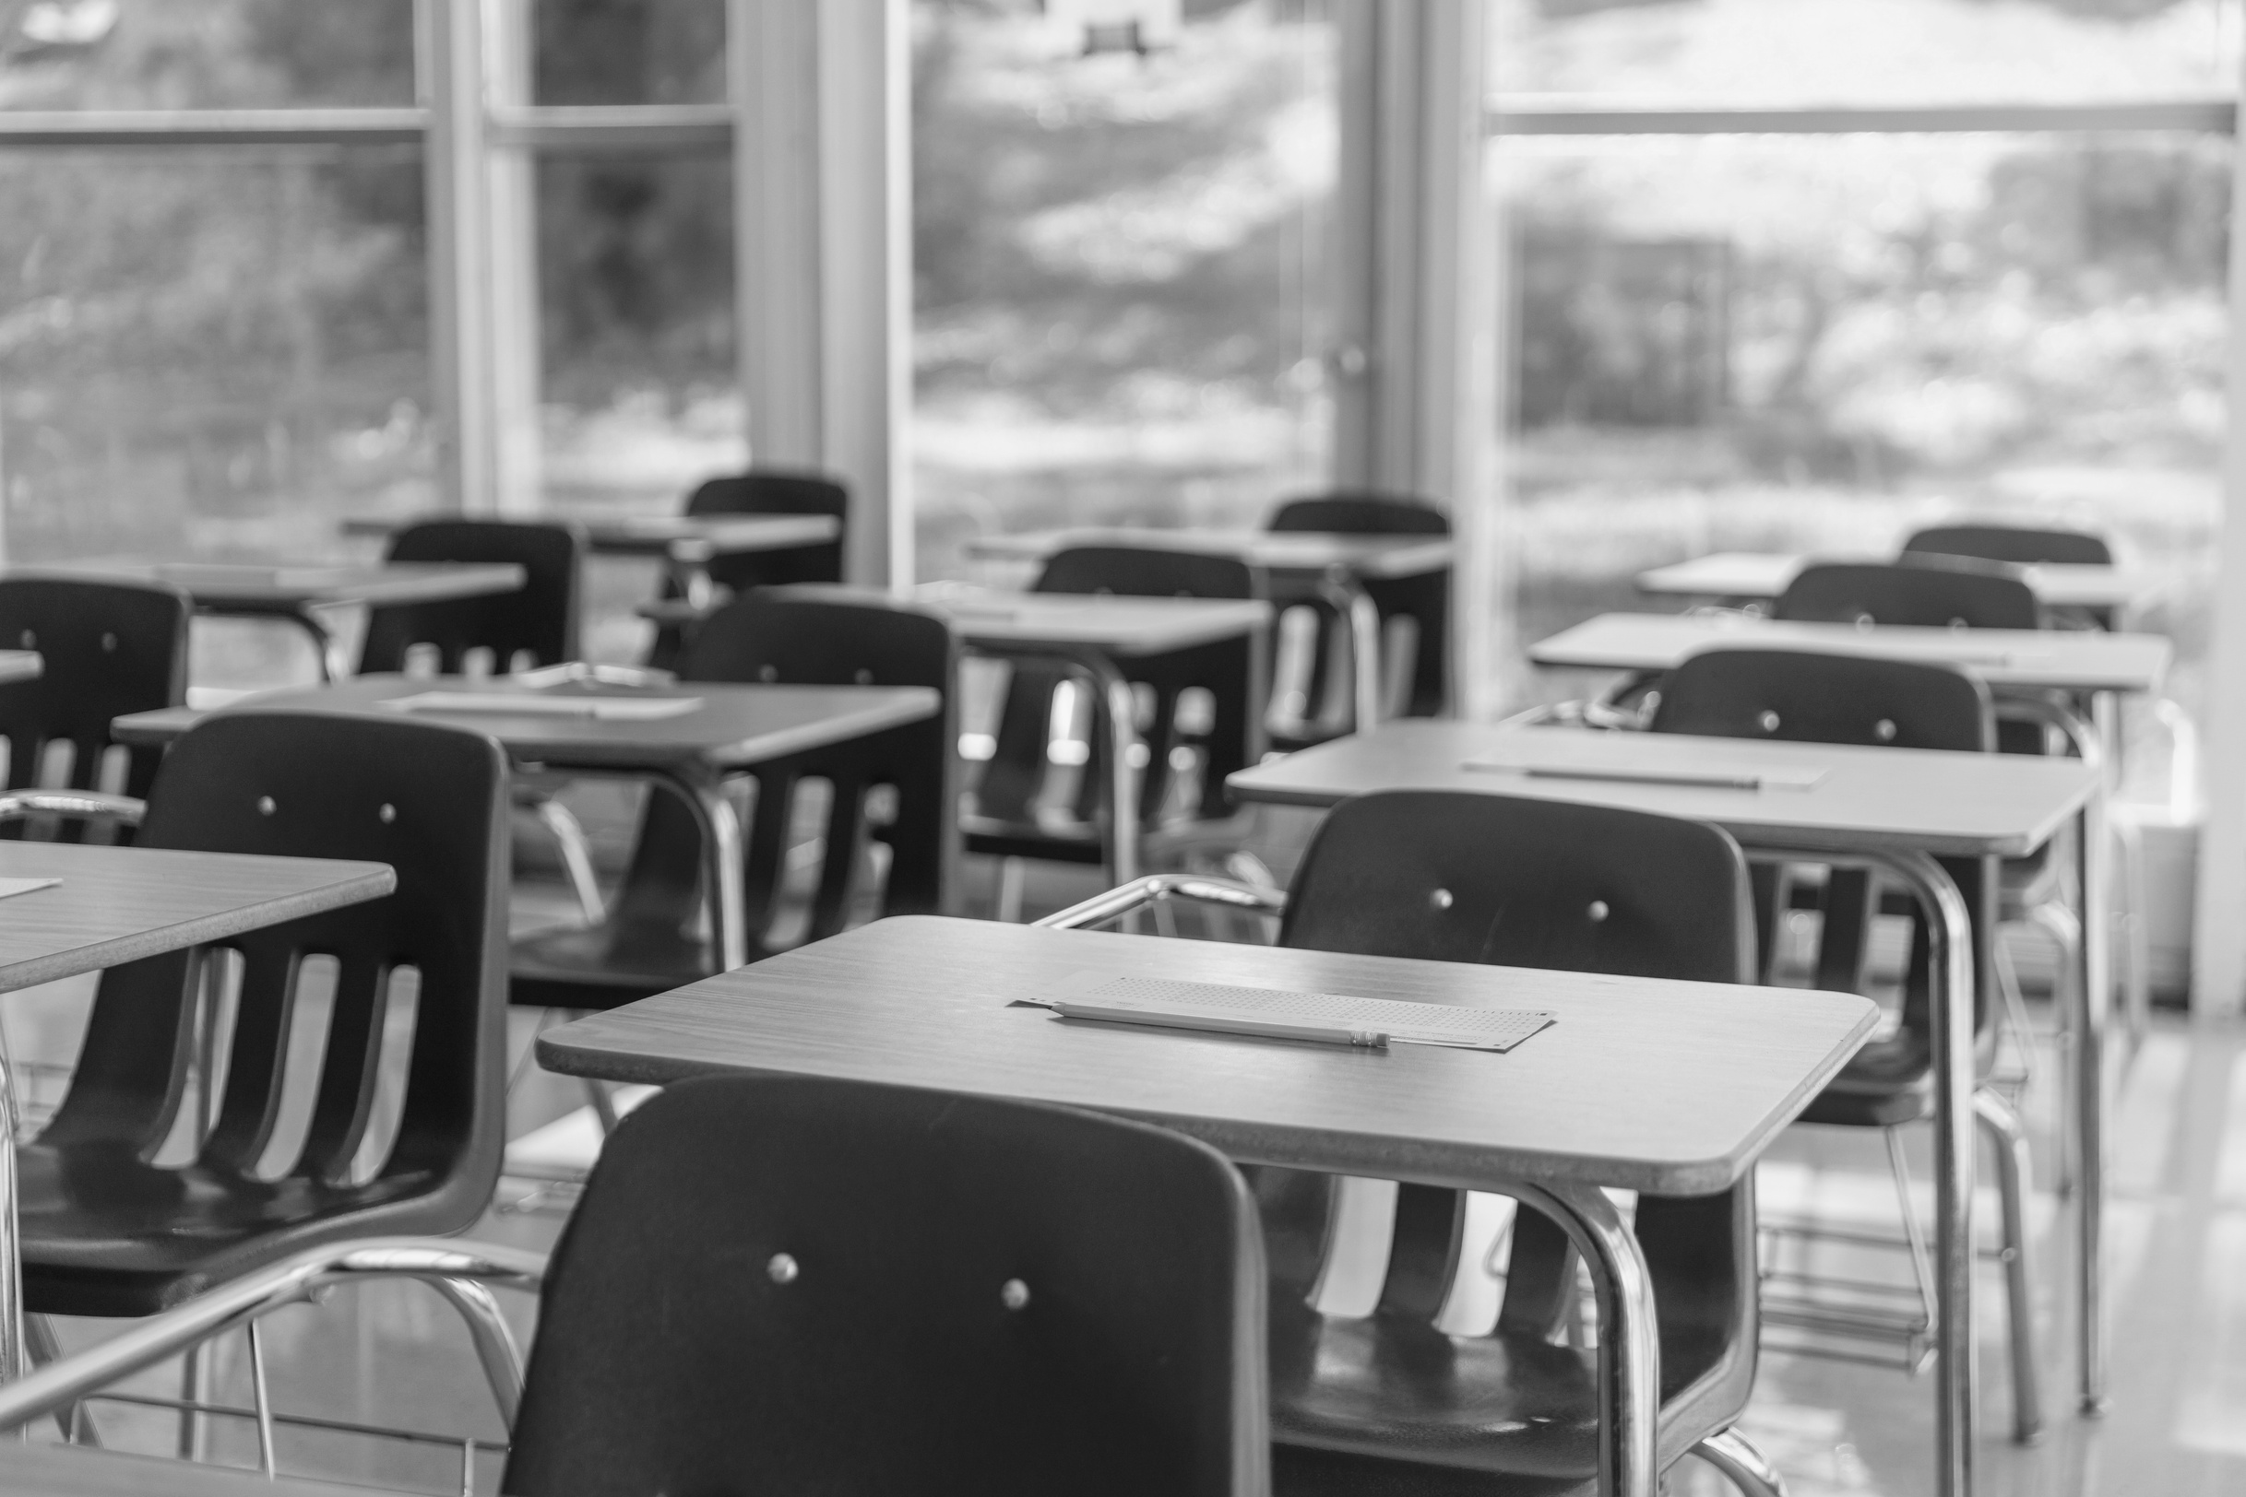
any questions?
COME SEE MRS. NAHORSKI, MS. PIAZZA OR MRS. ZELENAK

Slide 15
Thank You

